Slide 1
Exponential Moving Average and XGB Boost
By: Zayn Rekhi

Slide 2
Why Use Exponential Moving Average with Extreme Gradient Boosting?
Objective: Create a trading strategy combining both methods
Methodology:
EMA: helps in reducing noise from data, making it easier to identify trends.
Stock prices, sensor data, or weather forecasts
XGBoost: enhances predictive accuracy by capturing complex patterns and interactions.
Time-Series Forecasting, classification, regression
Hypothesis:
Together, they create a stronger model, especially for time-series forecasting and financial stock market data

Slide 3
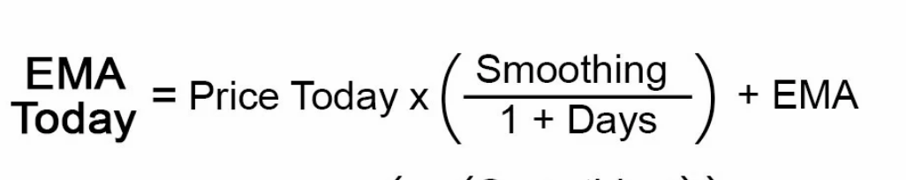
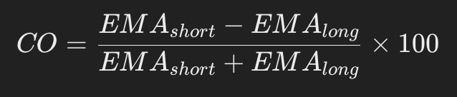
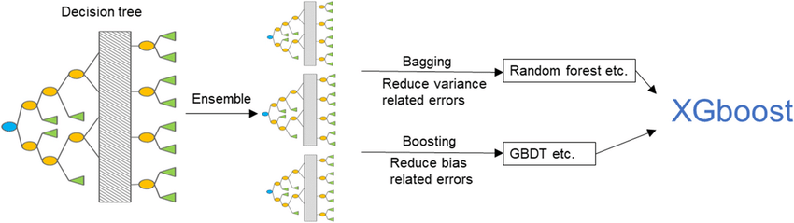
Steps:
Step 1: Smooth the data with EMA, EMA with Oscillator, and double EMA to remove the noise and highlight the bigger trends (eg. [p1, E1, E2, E3])
Step 2: Train the XGB model on all four data points to predict the future returns for a given stock
Step 3 (Strategy): Buy the stock if the return is positive
Step 4: Measure results using Sharpe Ratio

Slide 4
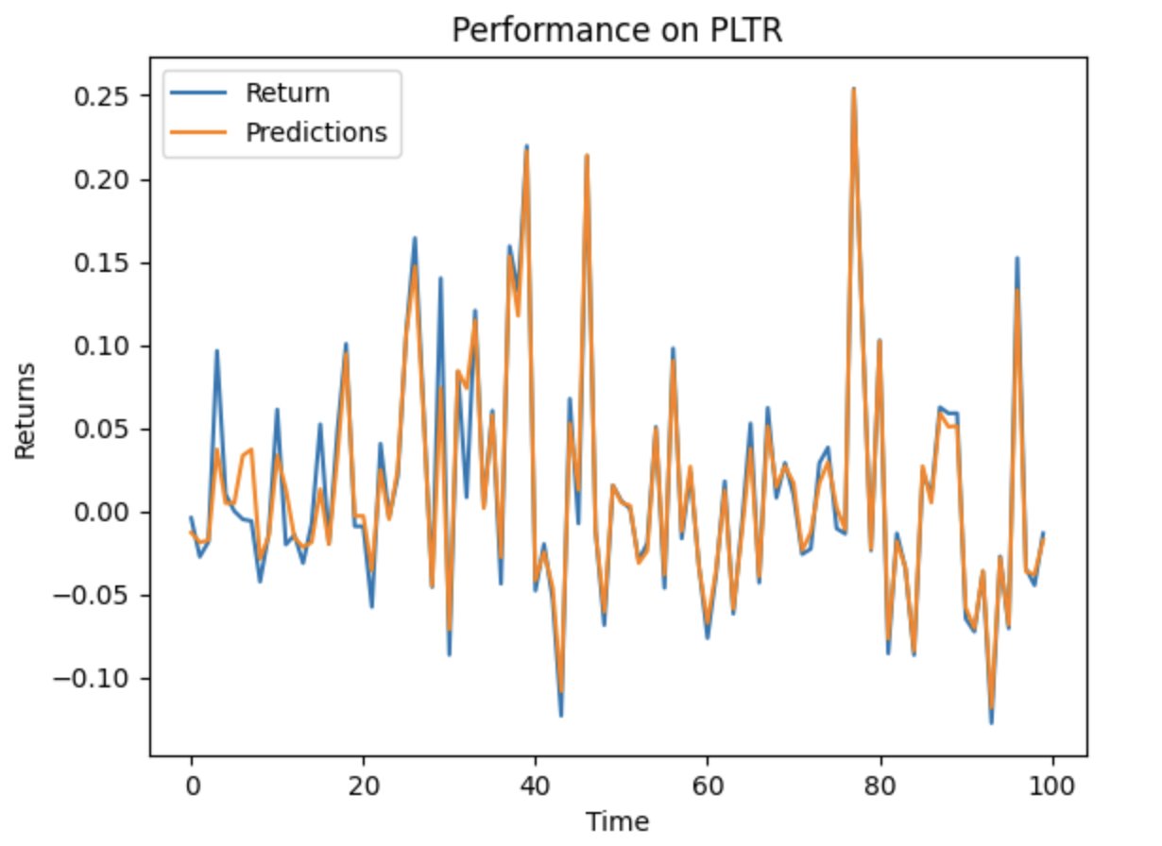
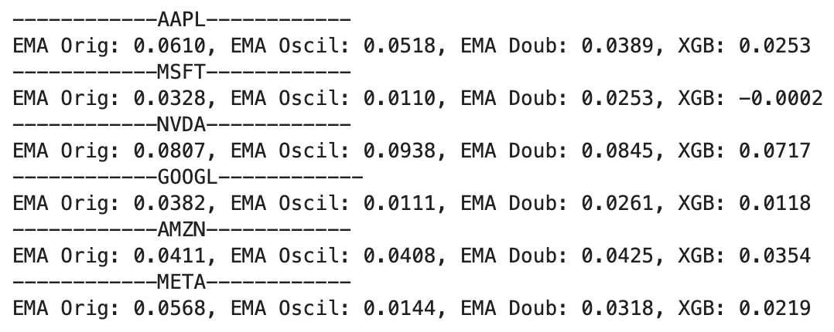
Conclusion/Results:
Extremely volatile returns: Complexity does not guarantee better performance

